Slide 1


2026.05.21
IP Case Law Conference 2026
How iconic marks are treated in South Korea?
JANG Ray
Trademark administrative judge of Board 2
xlay3209@korea.kr

Slide 2

Korean Trademark Act §34(1)9, §34(1)11, §34(1)13
§34(1)11 Any trademark likely to cause confusion with goods or business of another person remarkably recognized by consumers or to dilute their distinctiveness or reputation;
§34(1)9 Any trademark identical or similar to a trademark widely recognized by consumers as indicating the goods of another person, which is used on goods identical or similar to the goods of another person;
§34(1)13 Any trademark identical or similar to a trademark recognized as indicating the goods of a specific person by consumers in the Republic of Korea or overseas, which is used for unlawful purposes, such as unjust enrichment or inflicting loss on the specific person;

Slide 3
Specific criteria to assess “widely or remarkably recognized”
…Even where goods are dissimilar, a trademark identical or similar to another’s well-known mark may be refused registration if it is likely to cause confusion, and whether a mark is well-known is determined comprehensively based on factors such as duration and manner of use, transaction volume, business scope, and advertising, focusing on whether source recognition has widely spread in light of trade practices; recognition abroad alone is insufficient for such status in Korea, and the relevant point in time is the trademark filing date. …
The period, method, aspect, scope, etc. of the use of the mark, in addition to the course of trade, whether it is substantially known under the social norms, etc. should be examined.

Slide 4

Actual case 1
(This registered mark)
(Prior-used mark)
VS
Pharmaceuticals, etc.
Toys, etc.
IPTAB, denied, not invalidated under §34(1)11
Patent Court, invalidated under §34(1)11
Supreme Court, finally invalidated under §34(1)11

Slide 5
Specific criteria to assess “for unlawful purpose”
When determining whether there is a bad-faith intent, a comprehensive assessment should be made, taking into account factors such as: the degree of distinctiveness, originality of the imitated mark; the degree of identical or similar between the registered mark and the imitated mark; whether there were any negotiations between the applicant of the registered mark and the right holder of the imitated mark regarding the mark, and the content of such negotiations; any other relationship between the parties; whether the applicant of the registered mark had actually prepared to conduct business using the mark; whether the designated goods of the registered mark and those of the imitated mark are identical, similar, or economically related; and the actual conditions of trade. Such determination should be made based on the time of filing of the registered mark.

Slide 6
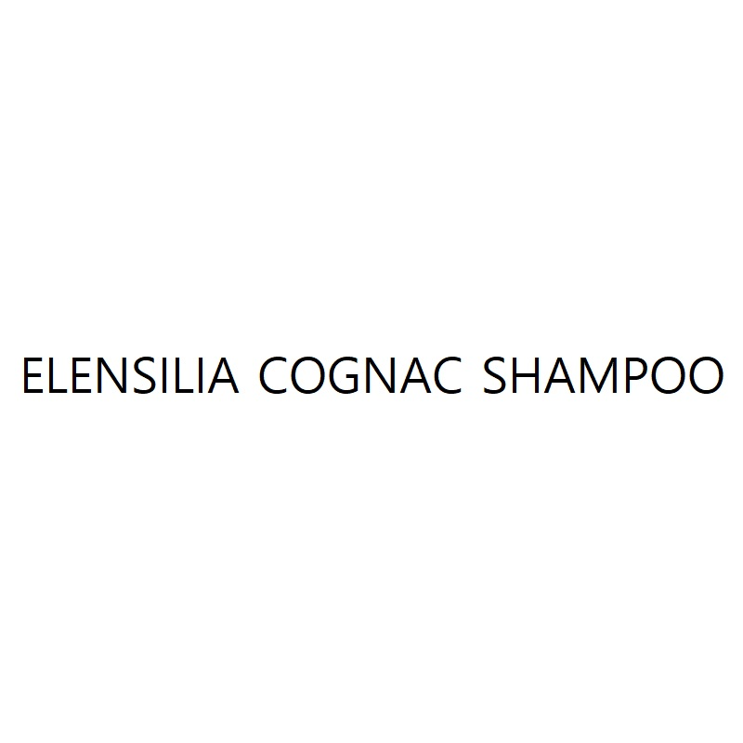
Actual case 2
(This applied mark)
(Prior-used geographic indication)
VS
Shampoo (containing cognac by-products)
Brandy
Trademark examiner, refused under §34(1)13
IPTAB, denied under §34(1)13

Slide 7
2026-05-21
JANG Ray
xlay3209@korea.kr

